Slide 1

Performance Assessment Report of Good Cabs for Strategic Growth

Slide 2

Good Cabs Revolutionizing Cab Services in Tier-2 Cities
Core Values
Supporting local drivers and ensuring excellent passenger service
Presence
Operating in 10 tier-2 cities across India
Mission
Sustainable growth while enhancing customer and driver satisfaction

Slide 3
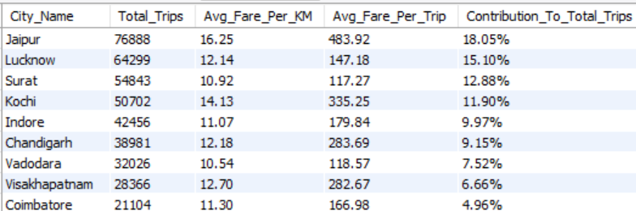
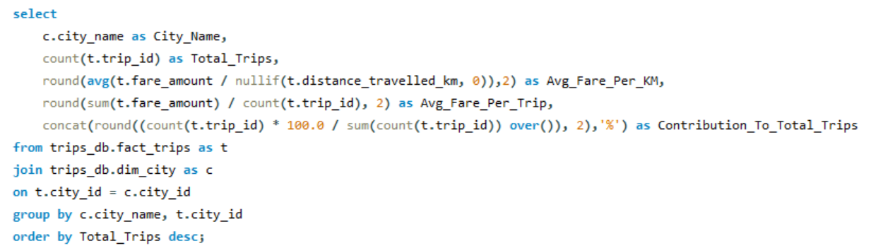
City-Level Fare and Trip Summary Report Assessing City-Level Performance
Understand trip distribution across cities
Evaluate pricing and revenue efficiency
Identify key contributors to overall trip volume

Slide 4
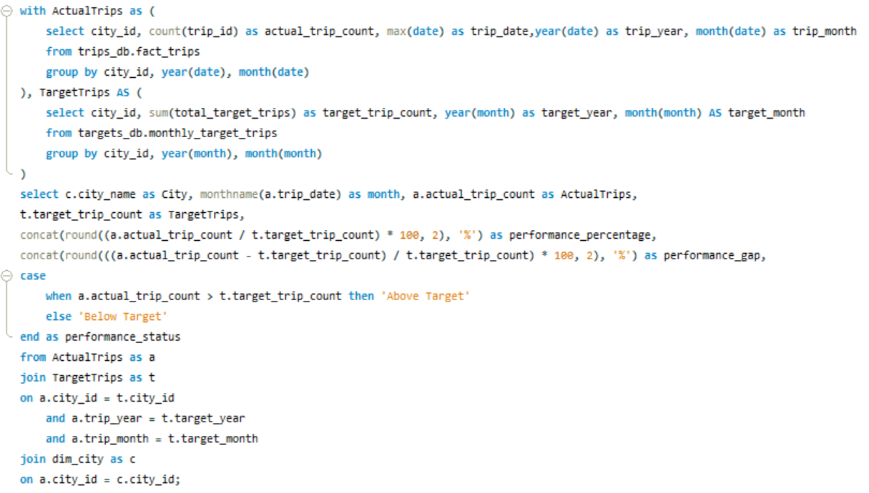
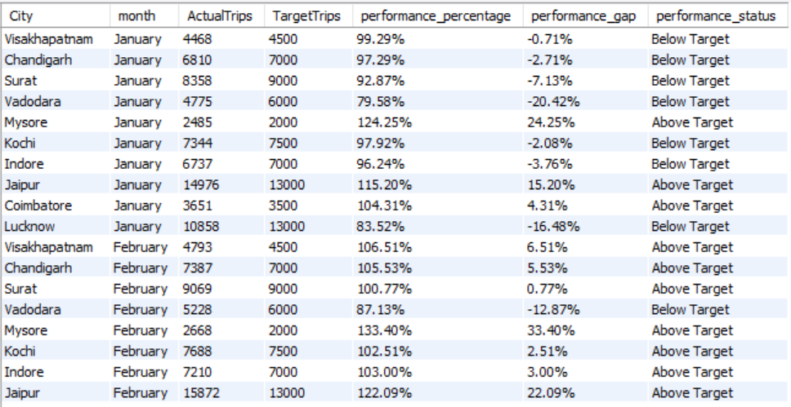
Monthly City-Level Trips Target Performance Report Evaluate and categorize trip performance against targets.
Monitor city-level and monthly performance
Quantify and address performance gaps
Drive strategic adjustments to meet or exceed targets

Slide 5
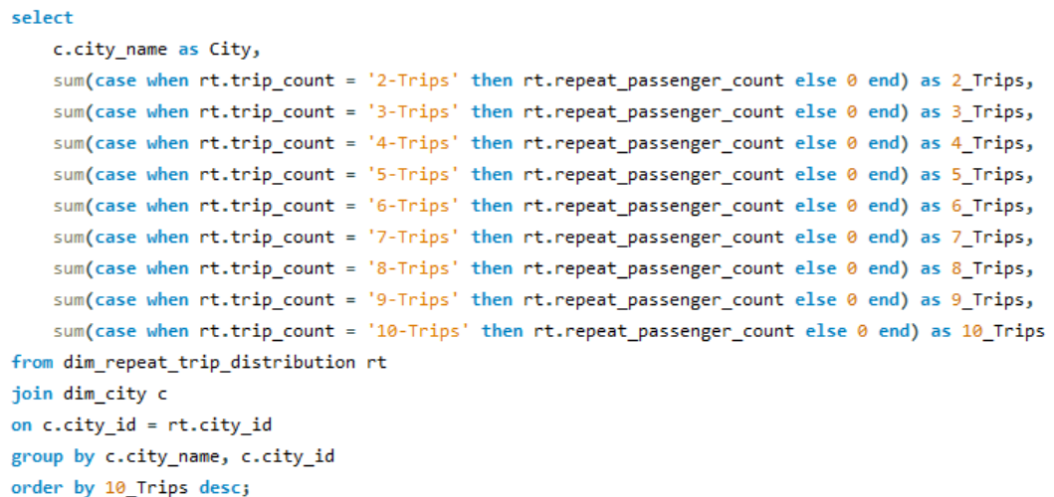
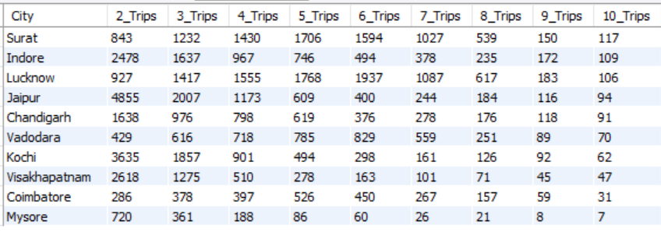
City-Level Repeat Passenger Trip Frequency Report Assess customer loyalty and usage patterns across cities
Identify cities with high repeat trip frequency
Understand patterns indicating strong customer loyalty
Provide insights to enhance repeat passenger engagement

Slide 6
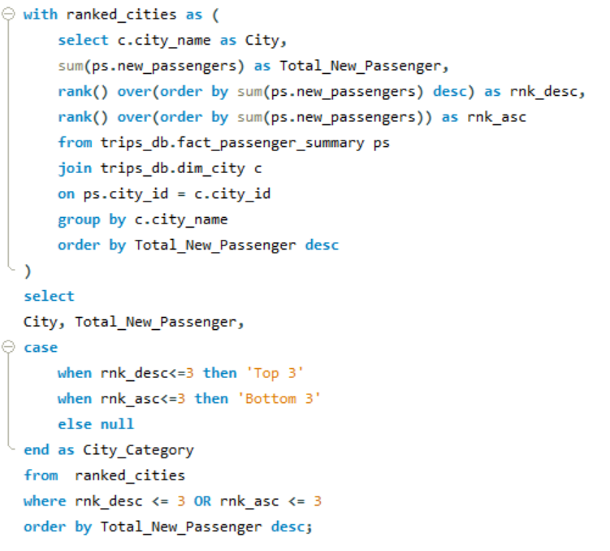
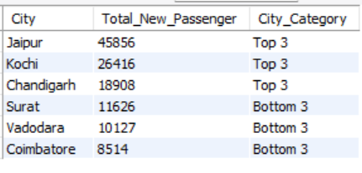
Ranking Cities by New Passengers Identify Cities with Highest and Lowest Total New Passengers
Highlight cities excelling in attracting new passengers
Identify areas requiring strategic focus to boost new passenger acquisition

Slide 7
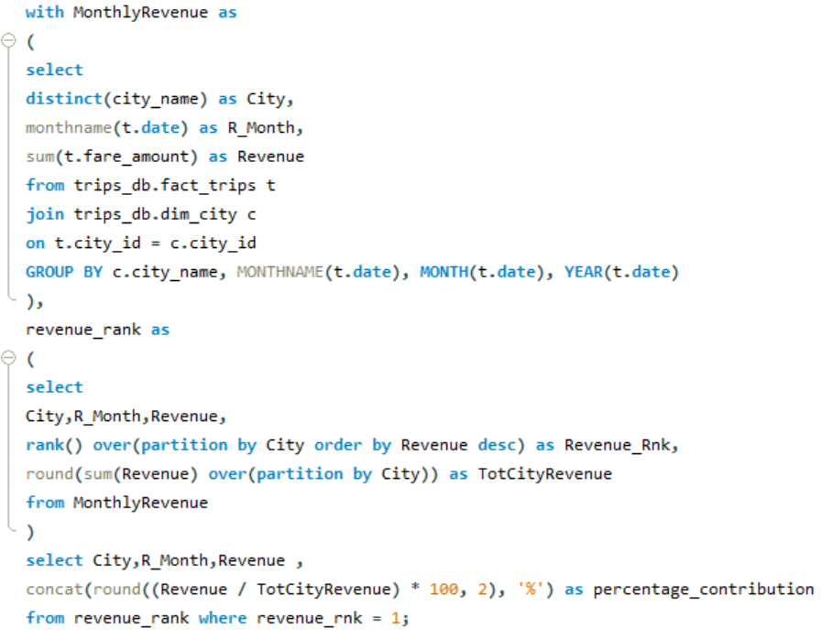
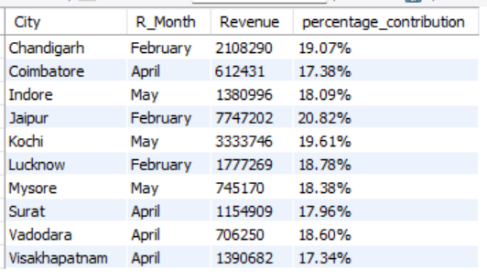
Identify Month with Highest Revenue for Each City Determine the month with the highest revenue for each city
Identify revenue peaks for better resource planning
Assess trends contributing to high revenue months
Support city-specific revenue growth strategies

Slide 8
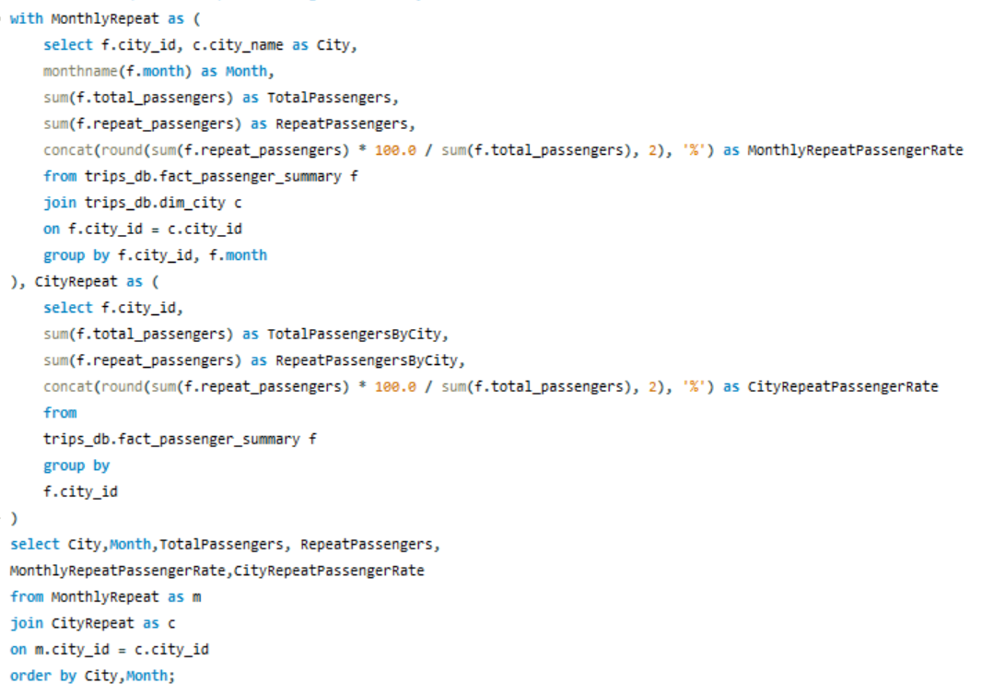
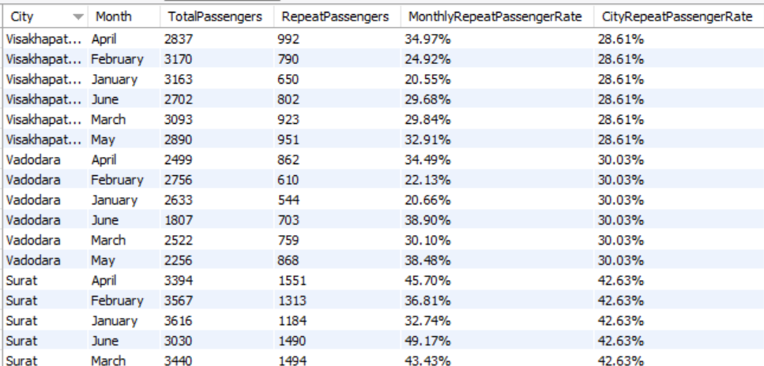
Repeat Passenger Rate Analysis Provide insights into monthly and overall repeat passenger behavior
Identify cities with consistent repeat passenger trends.
Assess loyalty patterns and their impact on overall performance.
Support strategies to enhance passenger retention.

Slide 9



Thank You
Isaiyamudhu Mahendiran
Connect with me

